Slide 1
MongoDB Extras
Olivier Liechti & Simon Oulevay
COMEM Web Services 2016

Slide 2


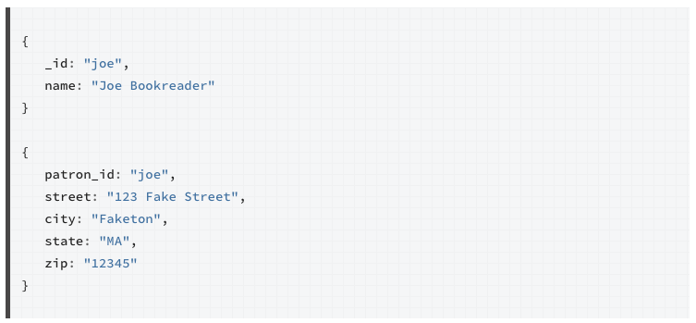
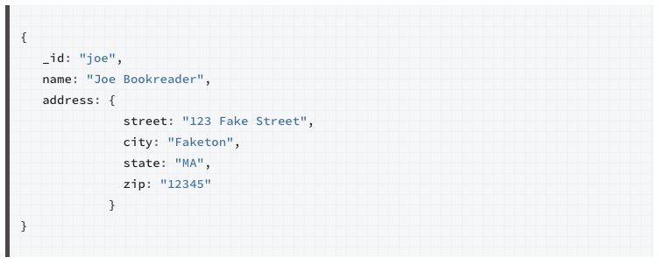

One-to-one relationships
2 documents (requires 2 queries to get all of the person data)
1 single, aggregate document
(in this case, it is a better choice)
Normalized data model
(references)
Embedded data model
(sub-documents)
https://docs.mongodb.org/manual/tutorial/model-embedded-one-to-one-relationships-between-documents/

Slide 3
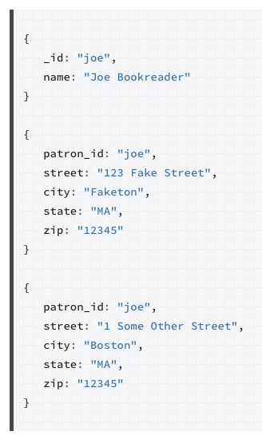
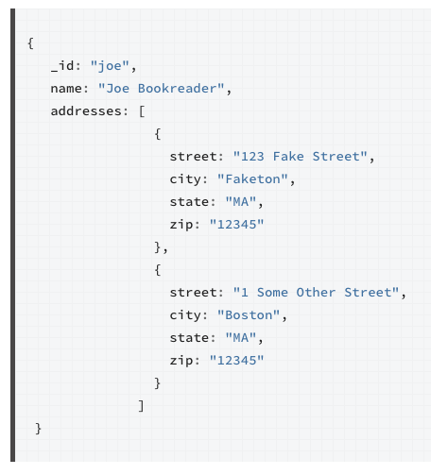

One-to-many relationships
MongoDB document can have an arbitrary structure, including arrays
https://docs.mongodb.org/manual/tutorial/model-embedded-one-to-many-relationships-between-documents/

Slide 4
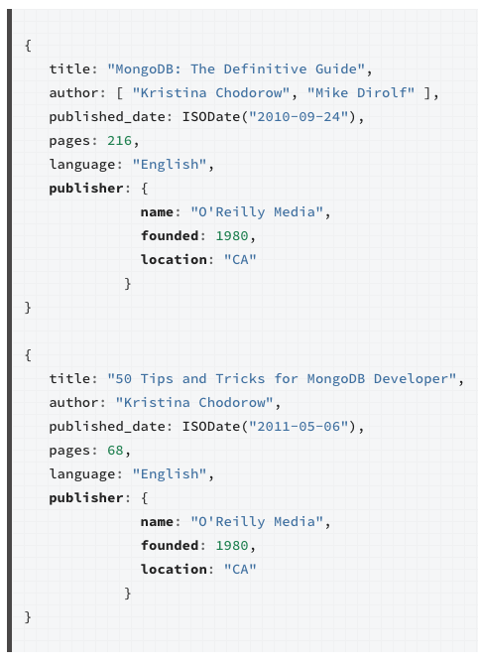

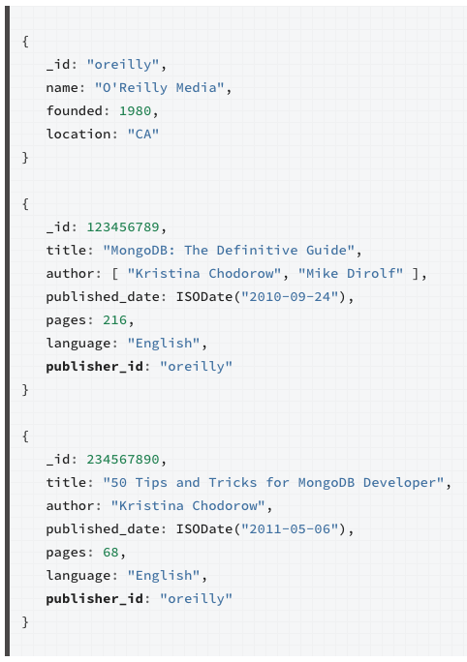
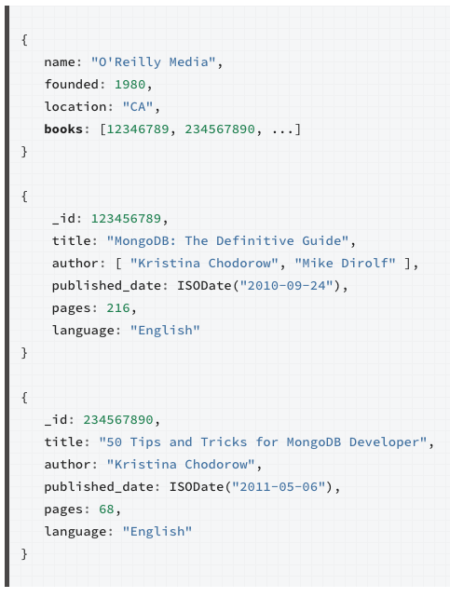



One-to-many relationships
ok if if have few books per publisher
duplication
better if you have many books per publisher
https://docs.mongodb.org/manual/tutorial/model-embedded-one-to-many-relationships-between-documents/

Slide 5
Relationships with Mongoose
var PublisherSchema = new Schema({
name: String
});
Manual reference
Reference through ObjectId
var BookSchema = new Schema({
title: String,
publisherName: String
});
var BookSchema = new Schema({
title: String,
publisherId: Schema.Types.ObjectId
});
Embedding
var BlogArticleSchema = new Schema({
title: String,
comments: [
{
body: String,
date: Date
}
]
});

Slide 6
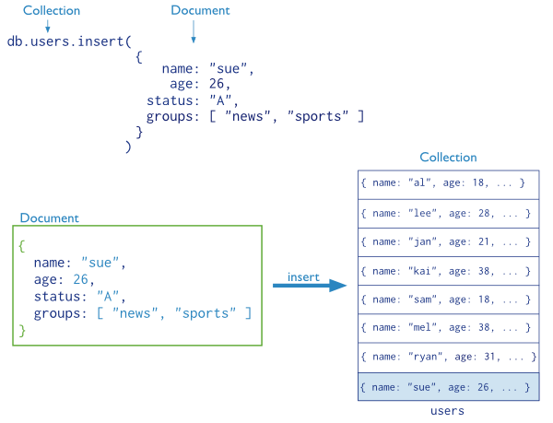

Insert data in MongoDB
To insert data in MongoDB, you simply have to provide a JSON document (with an arbitrary structure).
The documents in the collection do not have to all have the same structure (this is why we talk about a schemaless database).
A document is always inserted in a specific collection.
MongoDB will assign a unique ID in the _id field for the new document.
https://docs.mongodb.org/manual/core/crud-introduction/

Slide 7

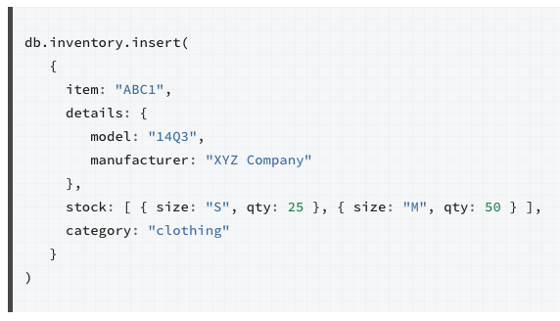
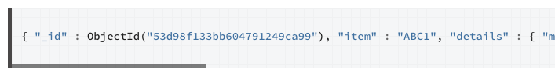
Insert data in MongoDB
This is one example. You can also insert multiple documents at the same time, either by passing an array of documents or by performing a bulk operation. If you are dealing with many documents, this is important for performance reasons.
https://docs.mongodb.org/manual/tutorial/insert-documents/

Slide 8
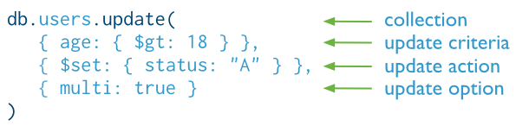
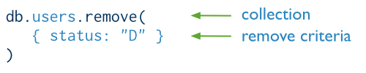
Update and delete data in MongoDB
When you update or delete documents, you specify which documents are concerned by the operation.
You do that by specifying update or remove criteria. Specifying "{}" means that you want to apply the operation on all documents of the collection.
https://docs.mongodb.org/manual/core/crud-introduction/

Slide 9

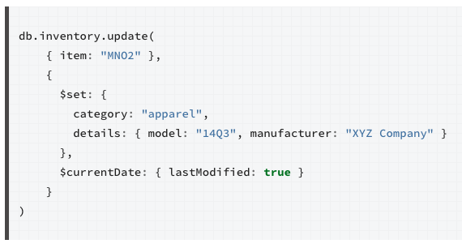
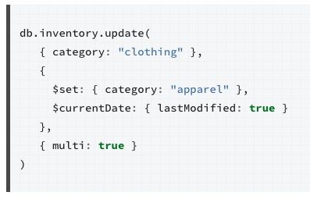


Update data in MongoDB
By default, update will modify only the first document that matches the selection criteria. You can specify the "multi" options if you want to update all documents that match the criteria.
selection criteria
update operators
lastModified will be set to the current date
https://docs.mongodb.org/manual/tutorial/modify-documents/

Slide 10
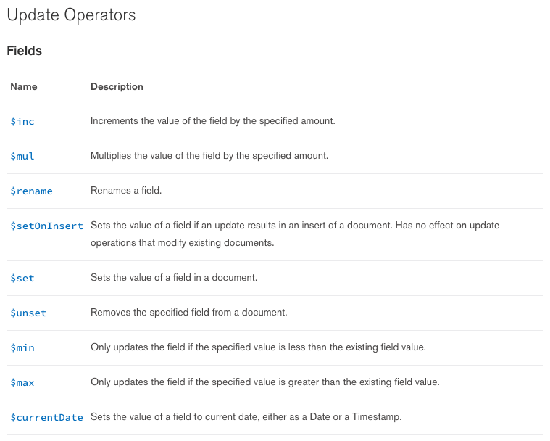
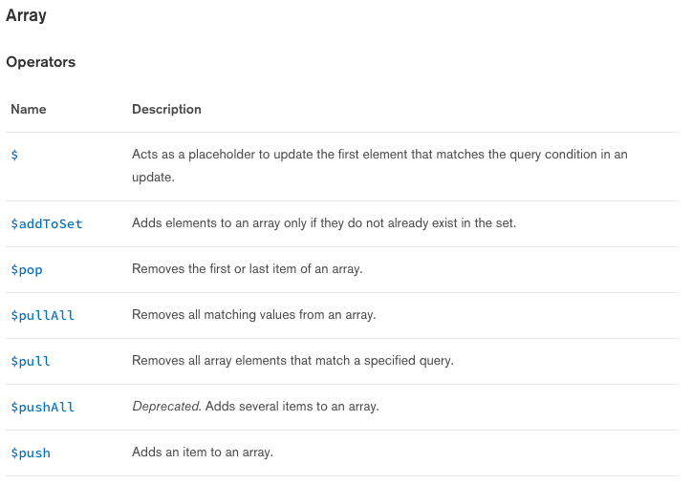
Update data in MongoDB
https://docs.mongodb.org/manual/reference/operator/update/

Slide 11
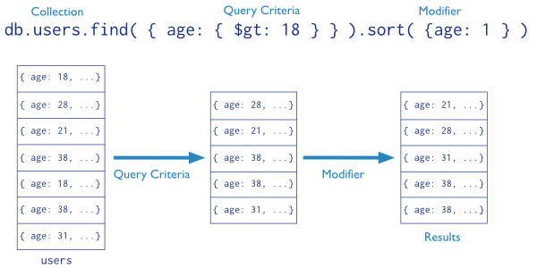



Query MongoDB
MongoDB is one of the most popular NoSQL databases (and one of the first to have been categorized as such).
We optionally sort the documents, limit the number of documents returned, etc.
We look for documents within one collection, within one database
We define the criteria for which documents should be considered, and which of their fields should be considered (projection)
https://docs.mongodb.org/manual/core/crud-introduction/

Slide 12



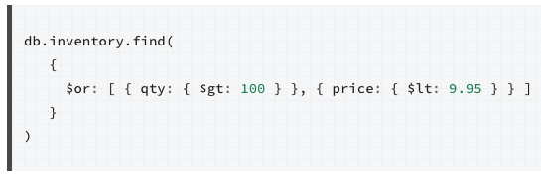

Query MongoDB
all documents
documents, which have a field "type" with a value of "snacks"
documents, which have a field "type" with have a value of "food" or "snacks"
documents with a type field equal to "food" AND a price field with a value less than 9.95
documents where the quantity is more than 100 OR the price is less than 9.95
https://docs.mongodb.org/manual/tutorial/query-documents/

Slide 13
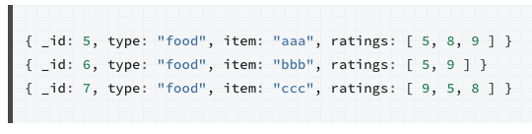



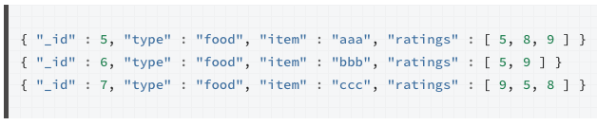
Query MongoDB: arrays
Exact match on the entire array
Return documents if the array contains a specific value
https://docs.mongodb.org/manual/tutorial/query-documents/

Slide 14

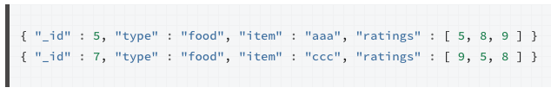

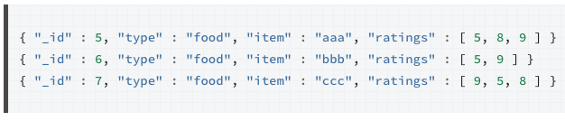
Query MongoDB: arrays
Documents where one element of ratings is at the same time > 5 AND < 9
Documents where there is one element of ratings > 5 and one element < 9
https://docs.mongodb.org/manual/tutorial/query-documents/

Slide 15
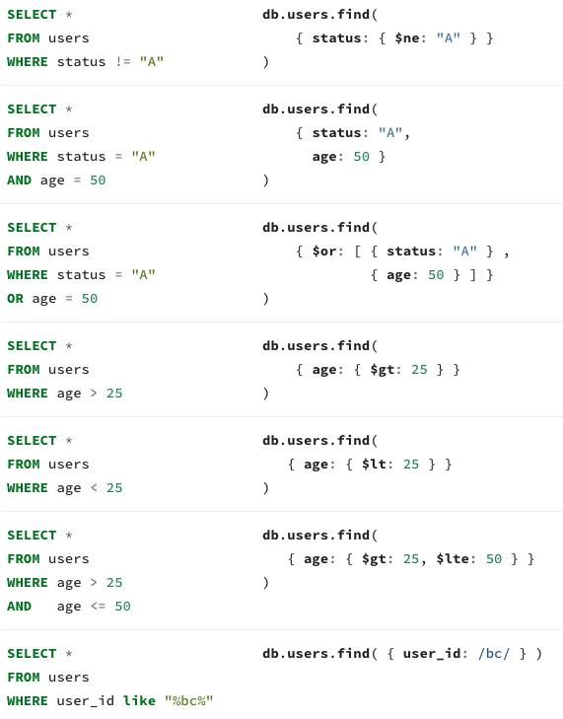
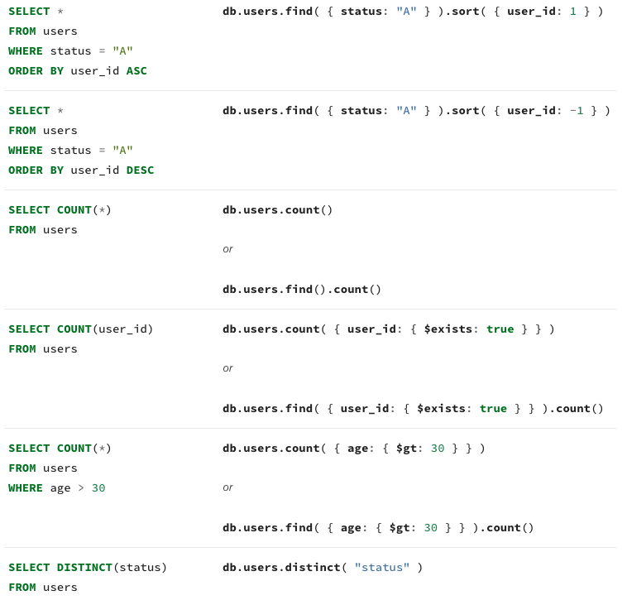
SQL vs MongoDB
https://docs.mongodb.org/manual/reference/sql-comparison/

Slide 16




Query MongoDB: projections
When you perform a query, you can specify which fields you are interested in (think about performance)
Return all fields (no second argument)
We are only interested by the item and qty fields (we will also get _id)
We are only interested by the item and qty fields (we really don't want to get _id)
https://docs.mongodb.org/manual/tutorial/project-fields-from-query-results/
We want all fields except type

